Slide 1



Erasmus Program
Changing lives, opening minds
DICMaPI Information Day of the Erasmus+ Call 2025/2026 February 28, 2025 at 11:00 a.m. - MicrosoftTeams

Slide 2


ERASMUS+
Erasmus+ is the mobility program wanted and financed by the European Union that allows university students to spend a period of study at a University in a different country with a financial contribution from the EU and with the possibility of following courses, taking exams and using the available facilities without paying the university registration fees. The educational activity (exams, internships) carried out in Erasmus is then recognized, both in terms of credits and grades, by the University of membership.
The Erasmus+ Program thus allows you to live cultural experiences abroad, to learn about new higher education systems, to improve your knowledge of at least one other language and to meet young people from other countries, actively participating in the construction of an increasingly united Europe.

Slide 3

The application must be submitted exclusively via the electronic procedure by 6/3/2025.
How to participate?
For all the information on how to participate in Erasmus+, please refer to the selection notice published in the News section on the website:
www.mobility.unina.it
Follow the application submission instructions on both the university website and the department website in the Erasmus+ announcement publication section

Slide 4
GENERAL INFORMATION
Erasmus+ mobility for study purposes is aimed at university students at universities in EU member countries, third countries associated with the programme (programme countries) as well as countries not associated with the programme (international mobility – non-EU countries) for:
attend courses and take the related exams;
prepare the thesis;
carry out research, internship, laboratory, etc. activities, provided for by the study plan. In particular, the internship may be carried out only if provided for by the teaching plan of the Study Course and combined with a period of study. The internship must be carried out under the supervision of the same University where the student will carry out the mobility.
Please note that the new Erasmus+ programme has imposed the digital stipulation of bilateral agreements through the Erasmus Without Paper platform, which is still in the technical implementation phase. Therefore, although the “Erasmus+ and International Mobility Office” is working on the confirmations of the agreements, the above-mentioned tables may be subject to updates and/or cancellations of destinations.
Furthermore, it is noted that the availability of mobility places is subject to change and is provisional and non-binding. The allocation of mobility is also subject to acceptance by the host institution.

Slide 5
GENERAL INFORMATION
The University is not responsible for any failure to accept students by partner institutions; foreign universities, in fact, may not accept students, even if they are successful in the selection process carried out by the University.
The reasons may be the following:
Deadlines related to the application form procedure:
many foreign universities require the selected student to fill out and send application forms (i.e. registration forms, accommodation reservation forms, course enrollment forms, etc.), by dates with strict deadlines. Failure to send the application form by the aforementioned deadlines will automatically result in the student being refused admission. In some cases, the deadline set by the foreign university may be very close to or before the period in which the university publishes the rankings.
Students are invited to consult, even before submitting the application, the website of the foreign universities chosen, in order to know in advance the deadlines established by the latter and any documentation and certifications to be produced;
Possible incompatibility between your study plan and the courses offered by the foreign institution: before applying, you must find out about the courses offered by the partner universities, to ensure that the foreign institution does not accept your study program proposal. For further details, it is advisable to contact the Exchange Promoter indicated in the exchange table attached to this selection notice and consult the website of the foreign institution of interest;
Language requirements requested by the foreign institution: more and more universities require a high level of linguistic competence. The student is required to find out about the language in which the courses are taught and any linguistic requirements requested by the foreign institution, by consulting the website of the host universities. For the requirements relating to linguistic knowledge, please refer to art. 7 of this Notice.

Slide 6

DICMaPI Agreements
To find out about all the agreements stipulated by DICMaPI, please refer to the table published in the Student Opportunities section:
https://www.unina.it/didattica/opportunita-studenti/erasmus/programma#p_p_id_101_INSTANCE_eQMIFo6IXmuz_

Slide 7




Scholarships
L Materials Science and Engineering (N50)and LM Materials Engineering (M68 – D11)
32
L and LM Chemical Engineering (N37/M55)
29
LM Industrial Bioengineering (P16)
8

Slide 8
MOBILITY TOWARDS SWITZERLAND AND UK ERASMUS+ 2025/2026
Mobility to Switzerland and the United Kingdom
With the entry into force of the new Erasmus+ programme, the United Kingdom and Switzerland are treated as non-EU countries. Students who are successful for locations in these countries must meet the same requirements set out in this Selection Notice for the programme countries.Students who intend to apply for British locations must consider that:1. it will be necessary to comply with the entry rules set out in the United Kingdom and, consequently, obtain information about the entry visa and health insurance;2. the costs of the visa, health insurance and any other costs required for entry into the United Kingdomor any other expenses cannot be covered by the University of Naples Federico II;3. many British universities, also to issue the invitation letter for the purpose of obtaining the Visa, based on the duration of the exchange, require ad hoc language certifications. It is advisable to carefully check the web pages of the host locations and, if necessary, contact them directly for more information.E+ National Agency Transition page (https://erasmusplus.org.uk/);VISAs (https://www.gov.uk/browse/visas-immigration);
Mobility to countries not associated with the program (international mobility non-EU countries)
The Erasmus + Program allows you to spend a period of mobility in a University (affiliated with UNINA) located in one of the following non-EU countries: Albania, Armenia, Chile, Japan, Israel, Kazakhstan, Morocco, Montenegro, Republic of Moldova, People's Republic of China, Ukraine, USA.All the requirements set out in this Selection Notice also apply to students applying for exchanges with Universities in non-EU countries (“General eligibility requirements”, “Language requirements”, “Selection procedures”). As established by the Erasmus + Program, specific financial contributions are, however, provided for these locations.

Slide 9
Application and Admission Requirements
Submitting the application
All students regularly enrolled in a three-year, single-cycle master's or master's degree course at the University of Naples Federico II are eligible for the selection. In any case, students must have an active career and be up to date with the payment of fees and contributions, under penalty of exclusion.
Students enrolled in the first year of three-year and single-cycle master's degrees must have acquired, as of 06/03/2025, at least 12 CFU (applications from students who do not meet the 12 CFU requirement will be automatically rejected).For students enrolled in two-year master's degree courses and for doctoral students/specialization schools, the 12 CFU requirement is not foreseen.
Students enrolled in the third year of a three-year degree can participate to leave during the first year of the continuity master's degree (same area), provided that they have been assigned a location that provides the second level of studies and at the time of signing the agreement, they are regularly enrolled in the first year of one of the master's degrees activated at the same Department.
It is mandatory for each candidate to have activated the institutional email address __@studenti.unina.it which will be the only tool used for all communications.

Slide 10
Selection
The selection is the exclusive responsibility of the Departments/ Schools and takes place, for students of the three-year courses of study, single cycle master and master on the basis of the following algorithms:
BACHELOR DEGREE (LT) AND SINGLE CYCLE (LMCU)
MASTER DEGREE (LM)
The actual CFU are those registered on 6/03/2025 and will be acquired automatically by means of a computer procedure on 12/03/2025. Students are invited to check the correct registration of the exams taken by the indicated date. The Erasmus+ and International Mobility Office is in no way responsible for missed or late registrations of activities/exams that may be useful for scoring purposes
The expected ECTS are conventionally identified on the maximum number of credits that students can achieve within the first semester of the year 2024-25 according to the following scheme:

Slide 11
Selection
 |  |  | EXPECTED CFU
 |  |  | year of enrolment
 | 1 | 2 | 3 | 4 | 5 |  | 6 | Out of course
LT | 30 | 90 | 150 | - | - | - |  | 180
LMCU | 30 | 90 | 150 | 210 | 270 |  | 330 | 300 o 360
LM | 30 | 90 | - | - | - | - |  | 120
Each Department may determine, where it intends to apply it, the factor «a», and/or additional evaluation elements to be added to the objective score generated by the formulas indicated, communicating on the departmental website.

Slide 12
Deadlines
Submission of the application no later than 12.00 on 6/03/2025.
The actual CFU are those registered on 6/03/2025 and will be acquired automatically by means of a computer procedure on 12/03/2025. Students are invited to check the correct registration of the exams taken by the indicated date. The Erasmus+ and International Mobility Office is in no way responsible for missed or late registrations of activities/exams that could be useful to of the calculation of the score.
The places for which there has been no assignment and/or acceptance in the first beat will be awarded to students who may qualify in the ranking for the second semester only.

Slide 13
Publication of the ranking
The ranking will be published on the website of the Department of Chemical Engineering, Materials and Industrial Production from 27-03-2025.
Any ranking and/or related allocation of the remaining scholarships will be exclusively for the second semester by 26-09-2025.
The grants will be awarded by the Erasmus Commission in a TEAMS meeting to which all students who have applied must attend, subject to exclusion.
The date on which the grants are awarded will be given due publicity.

Slide 14
DURATION OF MOBILITY
Mobility is provided for a minimum period of 60 days up to a maximum of 360 days and must be between 1 June 2025 and 30 September 2026.
Note: if you do not spend at least 60 days in Erasmus no contribution is recognized by the University, therefore the amount received must be returned.
In particular, activities carried out under Erasmus should be properly documented by submitting the Transcript of Records.

Slide 15
Award and acceptance of the Erasmus grant
Students awarded an Erasmus+ scholarship must accept the destination and identify the period of stay abroad (I semester, II semester or whole academic year) according to the dates and methods that will be published on the University’s website by the Erasmus+ and International Mobility Office.
The assigned destination may not be changed in any way, nor is it possible to request additional places to those provided for by the agreements in force.
FAILURE TO ACCEPT THE SEAT WILL BE CONSIDERED AS A WAIVER OF ERASMUS GRANT. ANY MOVES OR ASSIGNMENTS OF REMAINING VACANCIES WILL TAKE PLACE IN THE MONTH OF SEPTEMBER AND WILL CONCERN ONLY THE SECOND HALF OF THE YEAR.
DICMaPI will communicate the modalities and timing of the allocation of the remaining scholarships to those eligible in the ranking.
Although it is the Erasmus+ and International Mobility Office that "appoints" the winners (that is, to communicate to partner institutions the names and contact details of students who have regularly accepted the assigned destination), it is the student’s responsibility to inform himself about the administrative requirements and the respective deadlines foreseen by the partner locations; if not observed, the student could run the risk of not being accepted by the partner location. (Art. 1).
It is the students' responsibility to check the specific requirements (language, registration, course access) and application deadlines (application deadlines) at the host university by consulting the websites, the partner universities' information which the office publishes and updates, or by contacting the universities themselves.
Please note that:
the deadlines in the active exchange tables are subject to change by partner institutions;
Where the nomination and application procedures for the first half of the year have expired or are about to expire, the scholarships available are only for the second half.

Slide 16

Duration of the scholarship
The duration of the Erasmus+ 2025_2026 grant is set out in the Selection Notice for each destination and can be found in the last column of the CIPMP agreement table.
Erasmus+ provides that a student may receive the Erasmus grant several times for up to 12 months per cycle of study, regardless of the number and type of mobility (for study and/or internship purposes). The calculation of the Erasmus study period already completed also includes any extension for which no grant has been received.
For students enrolled in single cycle Master’s degree courses the maximum number of months is 24.
The period is in any case conditioned by the dates of beginning and end of courses and/or activities at the different universities of destination.
Study abroad must be between 1 June 2025 and 30 September 2026.
The date of departure and the duration of the period to be spent abroad must be established at the time of acceptance and are conditioned by the dates of beginning and end of courses and/or other activities at the different places of destination, as well as the number of months in the tables published on the Erasmus page of www.unina.it.
In any case, students who intend to study abroad for only one semester will not be funded for more than 5 months (with the sole exception of those whose duration is indicated differently in the table); students who intend to study abroad for a full academic year will not be funded for more than 9 months (with the only exceptions for those destinations whose duration is indicated differently in the table).
However, it will be possible to request a formal extension of the study period, agreed in advance with the host university.
No financial contribution is provided for the EXTENSION PERIOD, IF GRANTED.

Slide 17
Erasmus Agreement
The winning students - before departure - will have to sign the Erasmus financial agreement from which only the status of "Erasmus student" derives. The procedure for signing financial agreements requires that documentation be uploaded to the platform https://mobility.unina.it, section Career Attachments:
copy of application form, or acceptance letter from the host university, or self-declaration
the application form;
learning agreement;
certification of language skills;
Residence permit for international students.
The award of grants is conditional upon confirmation of all agreements by the partner universities.
The student will also have to verify that he or she meets any admission requirements required by the partner university (e.g. certified knowledge of the language in which the courses are held).
The student who has been awarded an Erasmus+ 2023_2024 grant, during his or her stay at the host university, cannot benefit from other Community scholarships and must regularly pay the university fees in the manner and time provided by the University of Naples Federico II.
Please note that any anomalies found in the uploading of documents on https://mobility.unina.it should be reported to international@unina.it.

Slide 18

Knowledge of the Language
It is essential that the students awarded a grant have a good knowledge of the foreign language in which the courses will be taught at the host universities. This knowledge must be documented at the time of SIGNING THE ERASMUS CONTRACT.
Language knowledge must be documented through the following certifications:
Certification issued by international bodies and/or institutions (e.g. IELTS, TRINITY, TOEFL, DELF, DELE,ZD, ZDfB);
Certificate of level issued by the CLA following placement tests (which students will be able to take free of charge). The CLA will organize several sessions for the placement tests distributed over the different semesters whose dates will be promptly communicated;
Certificate of level issued by the CLA at the end of the French, German and Spanish courses offered free of charge to Erasmus students in June/July;
Certificate of language proficiency from a foreign university where the student has completed an Erasmus period.

Slide 19

Knowledge of the Language
THE LANGUAGE TEACHER’S CERTIFICATION OF THE COURSE OF STUDY, NOR THE PASSING OF LANGUAGE EXAMINATIONS OF THE COURSE OF STUDY WITHOUT A SPECIFIC INDICATION OF THE LEVEL ACHIEVED WITHIN THE CEFR, IS NOT ACCEPTED, THE STUDENT MAY NOT BE REQUIRED TO DOCUMENT LANGUAGE KNOWLEDGE IF THE PARTNER UNIVERSITY DOES NOT REQUIRE IT, NOR ONLINE LANGUAGE SUPPORT (OLS).
Note: the certificate of knowledge of the English language is always accepted by the host institution, even if the local language is indicated in the dedicated field.
Upon arrival at the host foreign institution, the student is usually enrolled in language courses of the host country.
The following shall be exempted from the requirement to submit such documents:
1. students enrolled in the LM37 degree class or already holding the L11 undergraduate degree;
2. students attending the courses of study offered by Ateneo Federico II in English and who
will attend courses offered in English at the host university;
3. students selected on the DUAL TITLES;
4. students who have already uploaded the language proficiency certificate/certificate in process
consistent with the location assigned and with the level required and reported in the tables.
In addition, the European Commission has
provided online language courses.
For further information:
Centro Linguistico di Ateneo
e-mail: cla@unina.it
web: www.cla.unina.it

Slide 20

Financial Support
destinazione
Erasmus mobility grants are determined on the basis of days actually spent at the foreign university, as stated in the certificate of attendance (certificate of attendance).
The student mobility grant for the UK and Switzerland countries associated with the programme for study purposes consists of:
1) European Union contribution:
GROUP 1 HIGH cost of living | Austria, Belgium, Denmark, Finland, France, Germany, Ireland, Iceland, Liechtenstein, Luxembourg, the Netherlands, Norway and Sweden. Third countries not associated with the Region 14 Programme: Fær Øer Islands, UK, Switzerland | € 350,00
GROUP 2 AVERAGE cost of living | Cyprus, Estonia, Greece, Latvia, Malta, Portugal, Czech Republic, Slovakia, Slovenia, Spain | € 300,00
GROUP 3 LOW cost of living | Bulgaria, Croatia, Lithuania, North Macedonia, Poland, Romania, Serbia, Turkey, Hungary. | € 300,00
for everyone | ISEE< € 10.000,00 | € 250,00

Slide 21
Financial Support
2) Monthly contribution of the European Union for students with fewer opportunities
calculated on the basis of the value of the ISEE declarations valid for university performances submitted by students at the time of registration to A.A. 2024/25 and modulated according to the days of actual stay abroad. For students who apply as enrolled in the third year of Bachelor’s degree and will start as students enrolled in the first year of Master’s degree, the last ISEE declaration submitted for registration to this one will be taken into account and visible in the database. This is without prejudice to any further information that may be received in the meantime from the MUR and/ or the National Agency ErasmusPlus.

Slide 22
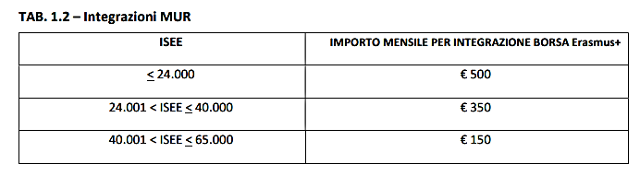
Financial Support
3) Supplementary contribution financed by the Ministry of Universities and Research (MUR),
Awarded on the basis of a breakdown in value bands of ISEE declarations valid for university performances submitted by students at the time of enrollment to A.A. 2023/24 and modulated according to the days of actual stay abroad. For students who apply as enrolled in the third year of Bachelor’s degree and will start as students enrolled in the first year of Master’s degree, the last ISEE declaration submitted for registration to this one will be taken into account and visible in the database. Without prejudice to any further information received from the MUR during this period.

Slide 23
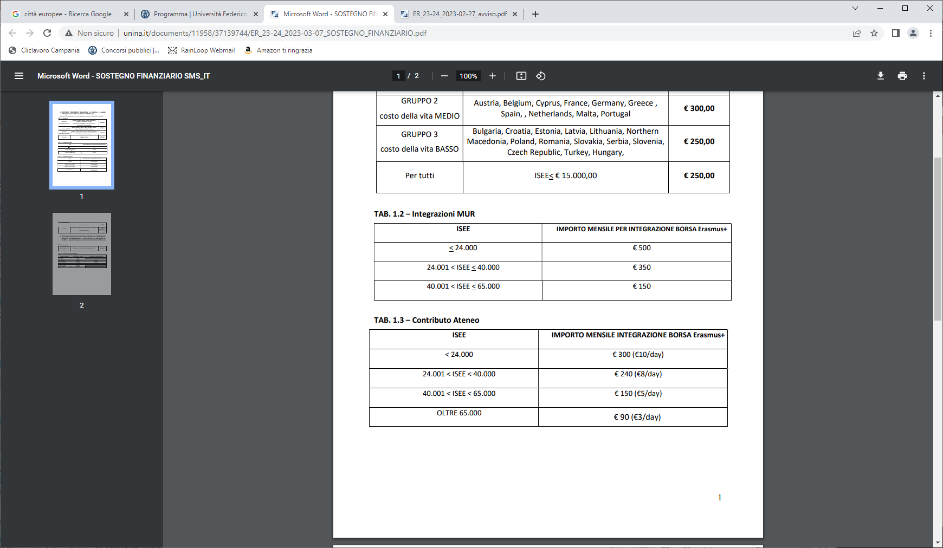
Financial Support
4) Additional contribution from the University,
Awarded on the basis of a breakdown in value bands of ISEE declarations valid for university performances submitted by students at the time of enrollment to A.A. 2023/24 and modulated according to the days of actual stay abroad. For students who apply as enrolled in the third year of Bachelor’s degree and will start as students enrolled in the first year of Master’s degree, the last ISEE declaration submitted for registration to this one will be taken into account and visible in the database.

Slide 24
Financial Support
PLEASE NOTE THAT THE ERASMUS+ AND INTERNATIONAL MOBILITY OFFICE USES THE INFORMATION AVAILABLE IN SEGREPASS FOR DETERMINING THE AMOUNTS TO BE PAID.
IT IS THEREFORE IN THE STUDENTS' INTEREST TO VERIFY THAT ISEE IS PRESENT.
UNDER NO CIRCUMSTANCES SHALL THE LACK OF AVAILABILITY OF THE ISEE BE CHARGED TO THE ERASMUS OFFICE OR LATE LOADING OF THE DOCUMENT BE USED FOR THE PURPOSE OF ADJUSTING THE AMOUNTS DUE.

Slide 25
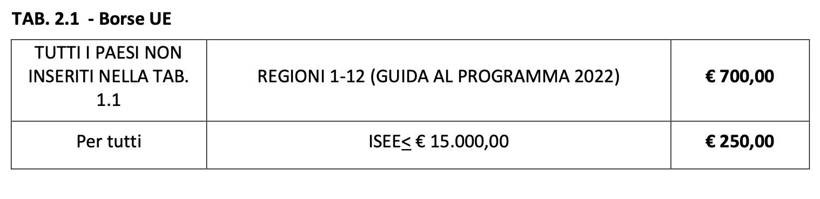
Financial support
NO EU
(not associated with the ERASMUS+ programme)
The grant for students on mobility to countries NOT associated with the international mobility programme - non-EU countries for study purposes consists of:
a) European Union contribution: this is a monthly amount modulated according to the days of actual stay abroad;
b) Monthly contribution for students with fewer opportunities;
c) Flat-rate contribution for the journey: this is a variable amount according to the distance travelled.
TAB. 2.2. – Flat-rate travel contribution KA131 and KA171 project 2024
travel distances | TRAVEL CONTRIBUTION | ECOLOGICAL TRAVEL CONTRIBUTION
10 – 99 km | 28 EUR | 56,00 EUR
100 – 499 km | 211 EUR | 285,00 EUR
500 – 1.999 km | 309 EUR | 417,00 EUR
2.000 – 2.999 km | 395 EUR | 535,00 EUR
3.000 – 3.999 km | 580 EUR | 785,00 EUR
4.000 – 7.999 km | 1.188 EUR | 1188,00 EUR
8.000 km o più | 1.735 EUR | 1735,00 EUR

Slide 26
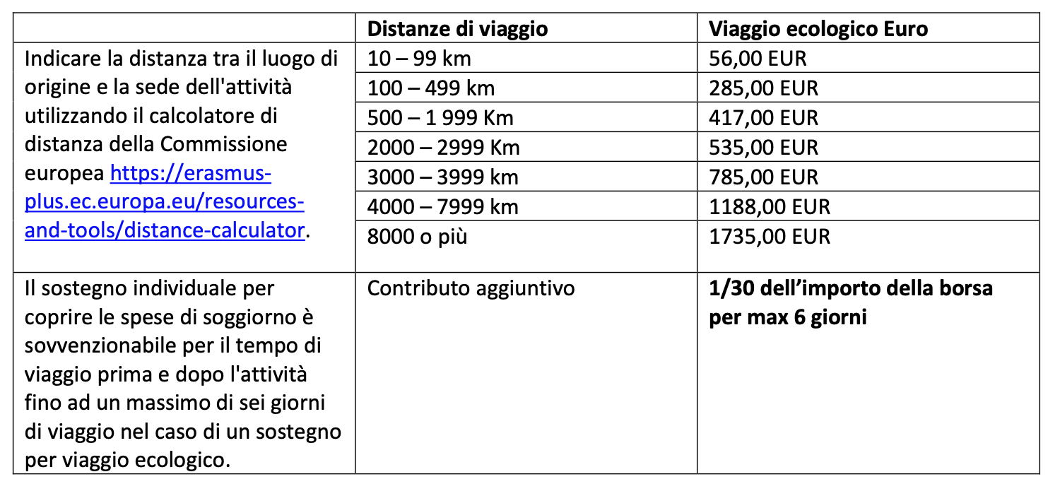
Financial support
Erasmus 2021_2027 Green Travel
The Erasmus 2021-27 Programme provides a contribution for the Green Travel (Green travel) for students who use predominantly, in terms of distances, a means of transport with low environmental impact (train, car sharing, bus). Individual support to cover living expenses is eligible for travel time before and after the activity up to 6 days.
Students interested in the contribution must upload their travel documents and self-declaration to the mobility.unina.it platform.

Slide 27


Financial Support
The timing of grants shall be set out in the financial agreement. The contribution is credited only to the IBAN of a current account or prepaid card in the student’s name/name in two tranches, the first tranche corresponding to the total amount less one month, The second is based on the actual duration of the Erasmus period resulting from the certificate of residence presented by the student (TOR and certificate of attendance). Students are required to refund the amounts for the days not covered by the certificate of residence itself.
Please note that if the IBAN is incorrect or corresponds to a c/c in which the person concerned is not the holder or joint holder, the amount of the scholarship is returned to the University which, for the reissue of the payment, is obliged to charge the recipient of the grant for bank charges.
It is reiterated that the amounts due will be paid on current accounts of which students must be registered or joint - whose IBAN codes must be entered in the application.
It is also necessary to check with your bank that any prepaid cards indicated for the receipt of the mobility grant have no credit limits.

Slide 28
Financial Support
The student to be eligible for the scholarship must have passed/ completed at least one of the activities provided in the learning agreement (exams, internship, thesis work) for each semester spent abroad. If not, the full amount of the grant must be returned. It will be true as indicated in the Transcript of Records (TOR) or alternatively for the internship and thesis work as certified by the teacher who will have followed the activities carried out by the student.
If the conditions are met, Erasmus students can participate in the selection for complementary scholarships issued by the Regional Company for the Right to University Study (ADiSURC), according to the deadlines and modalities provided by the Agency (www.adisurcampania.it).
Students with disabilities will be able to participate in the selection for supplementary scholarships based on the Circular of the National Agency which will be published in the Erasmus section of the website.

Slide 29

further clarification
attention
Those enrolled in a bachelor’s degree course, who expect to graduate before the departure date, will be able to take advantage of the study period abroad only after formal registration for the master’s degree (must have the master’s degree).

Slide 30

Guide for Erasmus students
For more information about the Erasmus+ programme, please visit:
https://erasmus-plus.ec.europa.eu/it/erasmus-programme-guide

Slide 31

Erasmus documents
application form
This term refers to the online form for enrollment at the host university as an Erasmus student.
As soon as the student has won an Erasmus grant, he or she is obliged to inform himself or herself about the modalities and time for enrollment, which vary considerably from university to university.
When applying, partner universities may request the following documentation:
Certificate of examination history in English;
insurance certificate
Copy of ID card
In some cases, in addition to the above-mentioned documents, foreign universities may require the submission of a Certificate attesting that they possess the language level required by the call.
The host universities may require special admission requirements such as a certified knowledge of the language in which the courses are taught.

Slide 32
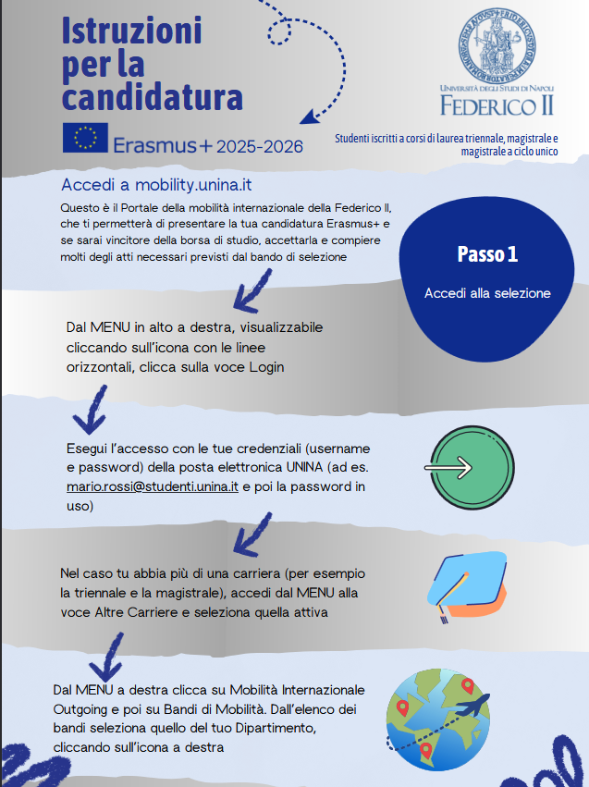
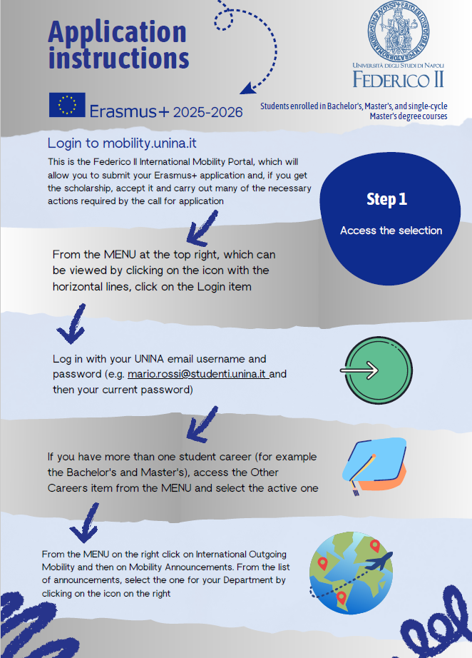

Slide 33
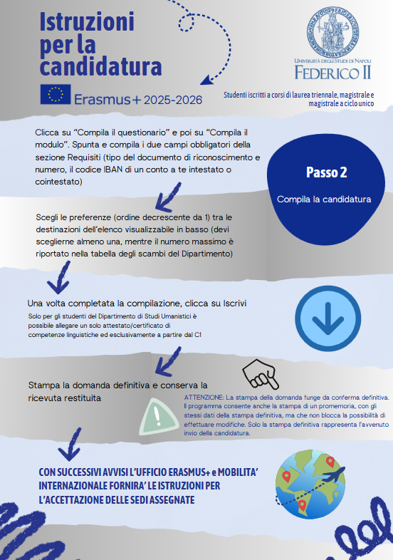
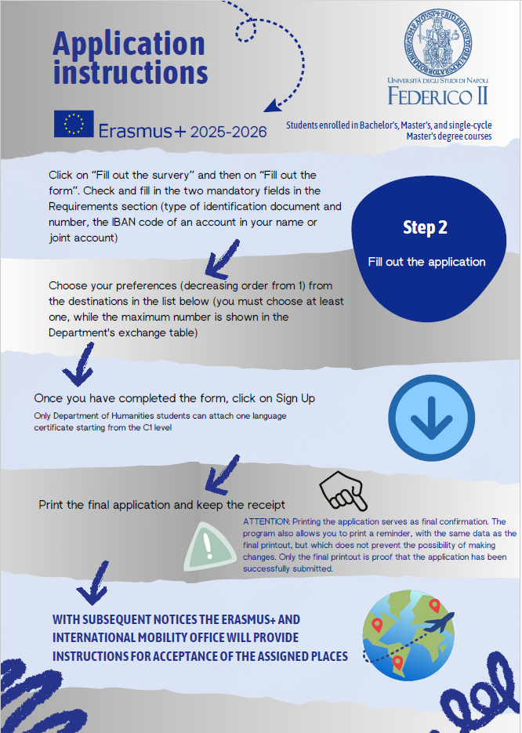

Slide 34
Destinazioni Erasmus

Slide 35
Erasmus Documents
Learning Agreement for Studies
Before departure, each Erasmus student must have a detailed plan of the activities to be carried out abroad - called Learning Agreement for Studies (LA) - approved and signed by the teacher promoting the agreement, by the course coordinator and the host institution.
In the LA will be indicated the courses that the student must attend abroad, the number of credits to be acquired and the Italian exams that will be recognized.
The LA is also mandatory in case the student carries out thesis, practice and internship activities abroad.
This plan may be modified during the Erasmus period (Changes during the mobility).
After the approval of the LA, the student must independently send the pdf of the approved LA to the International office of the destination University, requesting the signature for approval (which must be received before departure).
Once signed by the foreign office, the IA must be sent as a pdf to paola.desidery@unina.it.

Slide 36
Erasmus Documents
Learning Agreement for Studies
The learning must be uploaded to the OLA platform.
The Online Learning Agreement is the future of Erasmus+ student mobility in Europe. The OLA is the easiest and most convenient way to complete the Learning Agreement online, get it signed, receive comments from sending and receiving institutions and have an overview of the final version of the document.
The OLA can be used by students participating in an Erasmus+ mobility for study or traineeship between Higher Education Institutions holding the Erasmus Charter for Higher Education.
How do I access the OLA platform? You can access the OLA platform using your academic credentials.
For more info consult the university guide:
https://www.unina.it/didattica/opportunita-studenti/erasmus/programma#p_p_id_101_INSTANCE_eQMIFo6IXmuz_

Slide 37
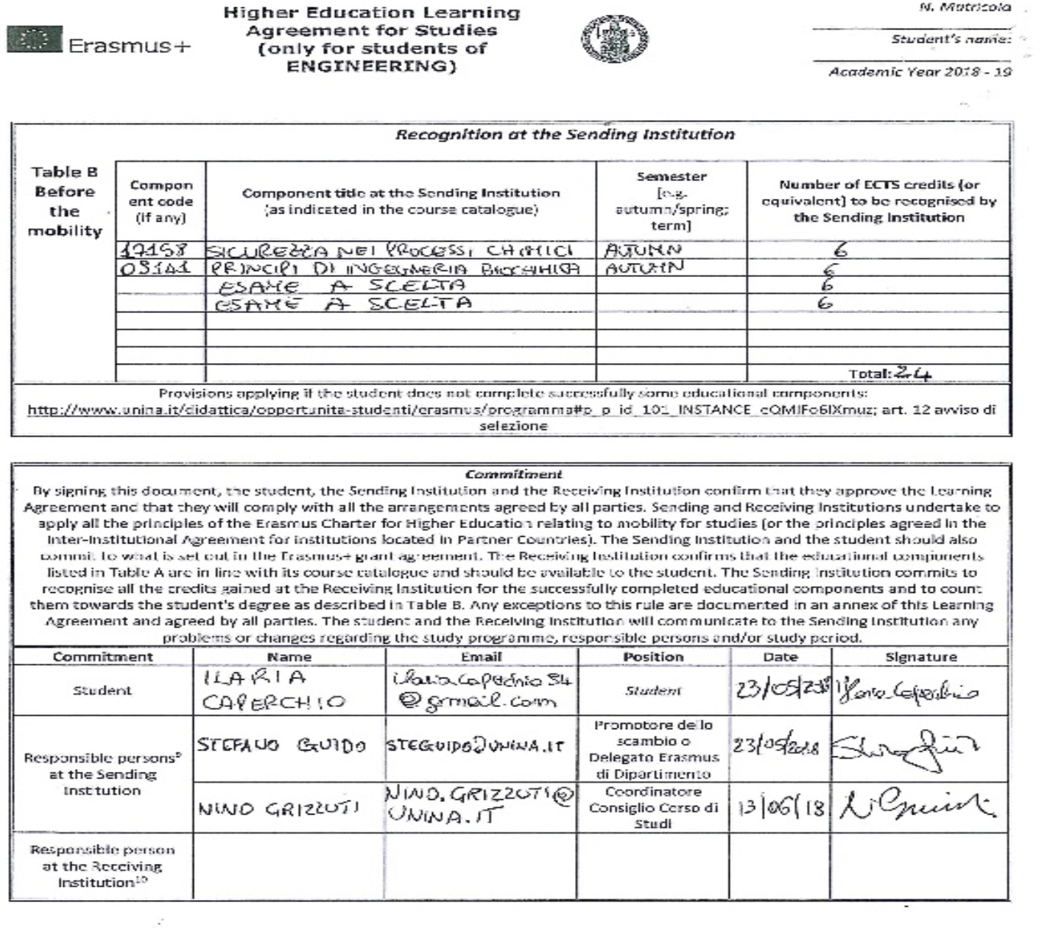
Example of a Learning Agreement for Studies

Slide 38
Erasmus Documents
Erasmus contract
Winning students - before departure - must sign the Erasmus financial agreement.
The procedure for signing financial agreements requires the following documentation to be uploaded on the platform https://mobility.unina.it , section career attachments :
Copy of the application form, or letter of acceptance from the host university or self-declaration regarding the application form
Copy of the language certificate
Learning Agreement
Residence permit for international students.

Slide 39

Services and Insurance Coverage
Students awarded an Erasmus grant are insured during the course of their institutional activities against accident and third-party liability risks. The insurance terms and conditions can be consulted on the University portal in the Erasmus page in the document: "Insurance coverage for Erasmus+ students - SHORT GUIDE"
https://www.unina.it/documents/11958/21043453/ER.2020.21_guida.copertura.assicurativa.pdf

Slide 40

health care
For health coverage during the stay abroad in European Union countries of Italian citizens, it is sufficient, generally speaking, to bring with you the European Health Insurance Card (TEAM) which allows for health coverage limited to the necessary care.
For detailed information on your rights and obligations in the field of healthcare abroad, please contact your ASL or visit:
http://www.salute.gov.it/

Slide 41

Accommodation abroad
The student who has won the Erasmus grant will be cared for and contact as soon as possible the relevant offices of the foreign university to find accommodation.
Many foreign universities offer accommodation to Erasmus students and for this purpose they prepare an application form (accomodation form) that the student is required to fill out and return as soon as possible.
It is essential to comply with the deadlines set by the host universities, this is the only way to be able to guarantee the right to receive accommodation.
If not, the student will have to do it himself (however, we recommend that you contact the host university for assistance and information). For large universities, the search for accommodation is entirely up to the student.

Slide 42

Once you arrive abroad
The student must immediately go to the Erasmus Office of the host University, fill in the Certificate of Attendance in the "Arrival" or »In» box and send it by mail to the Erasmus and International Mobility Office and the Erasmus Manager of DICMaPI(desidery@unina.it).
The student must also have the Learning Agreement approved by the host University, if it has not already happened.

Slide 43
Recognition of activities carried out abroad
Presentation of the Transcript of Records
Recognition of activities supported abroad
For the recognition of the activity supported abroad during the Erasmus period, please contact the Lecturer promoting the agreement or the Coordinator of the course of studies.
The recognition of the activity supported abroad must be in accordance with the approved Learning Agreement and on presentation of the Transcript of Records.
For the recognition of activities carried out abroad, the ToR must be sent to:
desidery@unina.it
direzione.dicmapi@unina.it
For the settlement of the balance of the grant, the ToR must be sent to:
international@unina.it
Failure to do so will not guarantee the recognition of Erasmus credits.
TRANSCRIPT OF RECORDS
This is the document which, at the end of the study period, the host Institute must hand over to the Erasmus student or send to Federico II and which attests the results obtained. On the basis of this document, the procedures for recognition of the period of study abroad will be initiated.
The transcript of records must be dated, stamped and signed on letterhead from the host university.
It is advisable to always check the contents of the transcript and, in case there are errors, go promptly to the Student Secretariat of the Host University for any corrections.

Slide 44
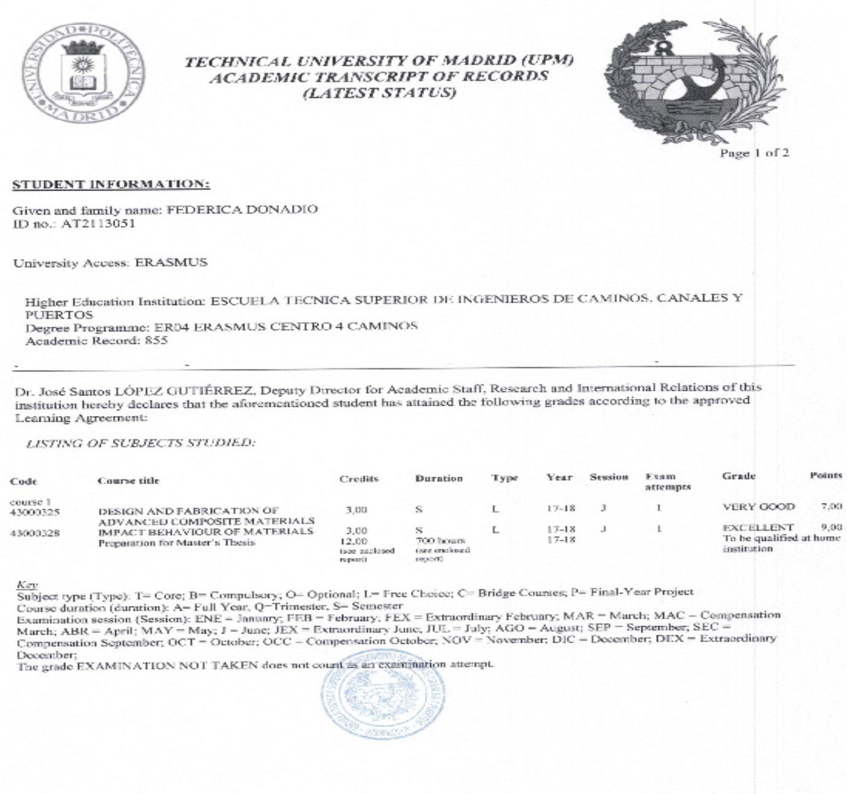
Example of Transcript

Slide 45

Upon return
The student, within seven days of return, under penalty of revocation from the status of "Erasmus student" and consequent recovery by the University of the funding granted, must deliver Erasmus and International Mobility
In addition, the student must have completed OLS, second assessment, the mandatory online questionnaire to receive the last monthly Erasmus grant.
Certificate of attendance indicating the start and end dates of the Erasmus period;
the Learning Agreement, with any modifications, signed by the host university;
the Transcript of Records (TOR) or in case of thesis, internship or other practical activities a certificate certifying the work done.
Optional: Short video or description of your experience with data processing permission for use of the material.

Slide 46

Useful contacts
For the administrative aspects relating to Nomination, Erasmus Contract, Grant Payment, Closing of Erasmus Period contact:
Erasmus and international mobility office
Headquarters: Via Mezzocannone
Head of Office: Marta Maciocia
Head of Engineering: Luigia Mondo
international@unina.it
For the administrative aspects of Selection, reception, help desk:
Office for Teaching at the CIFMPI
Head of Office: Paola Desidery
desidery@unina.it
Marco Barreca
marco.barreca@unina.it
Antonia Collini
antonia.collini@unina.it
Felice Sansone
Felice.sansone2@unina.it

Slide 47
Useful contacts
For all educational aspects, contact the Erasmus Course Coordinators and Course Coordinators:
- for Chemical Engineering and Erasmus Delegate for CIGMP :
prof. Giovanna Tomaiuolo – giovanna.tomaiuolo@unina.it
coordinator : prof. Giovanni Ianniruberto: giovanni.ianniruberto@unina.it
- for Industrial Bioengineering:
coordinator : prof. Maurizio Ventre – maventre@unina.it
referents : dott.ssa Enza Torino enza.torino@unina.it - David Dannhauser david.dannhauser@unina.it
- for Materials Science and Engineering and Materials Engineering :
coordinator : pro. Ernesto Di Maio– ernesto.dimaio@unina.it
referents : prof.ssa Veronica Ambrogi – ambrogi@unina.it
Study course pages:
http://www.ingchim.unina.it/
www.scingmat.unina.it
http://bioengineering.unina.it/
Department's website :
www.dicmapi.unina.it

Slide 48

Presentation of the Erasmus Information Day of the DICMaPI
Thank you for coming!!!
Curated by the Office for Didactics of DICMaPI

Slide 49

ENJOY YOUR EXPERIENCE

