Slide 1
Unina Training
access to courses on the site Federica.eu

Slide 2
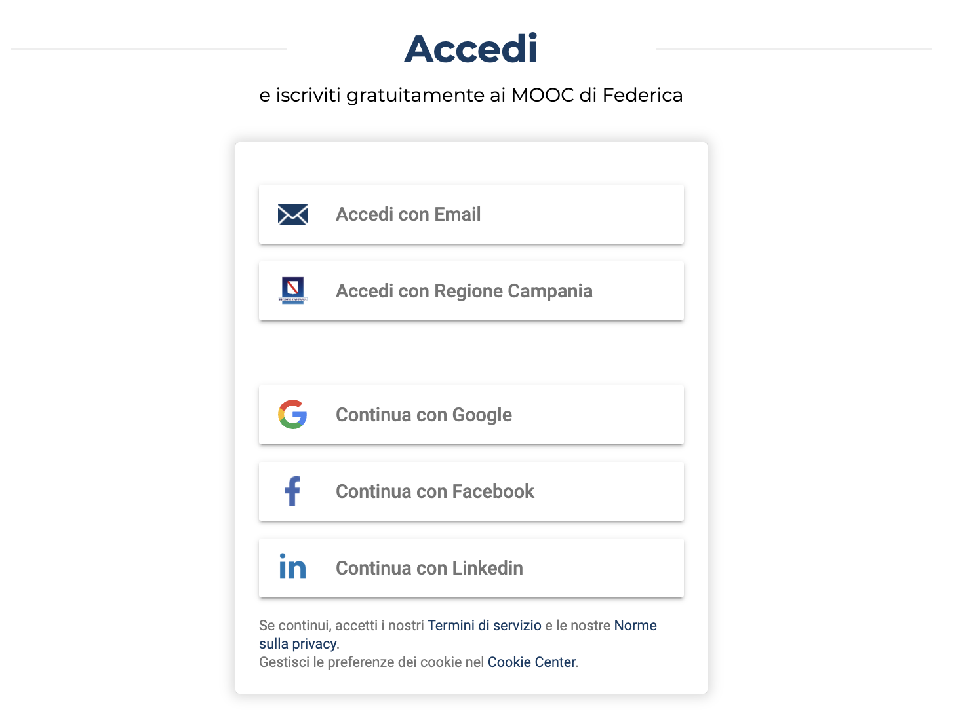
step 1
Sign in Federica.eu
by entering your UNINA credentials
If you are not registered at federica.eu, you can register here

Slide 3
step 2
Click here:
Unina in Formazione
and access the course

Slide 4
step 3
Sign up here for
the course

Slide 5
step 4
step
To access the course you need to enter the ACCESS CODE!

Slide 6
step 4.bis
For internal STAFF, enter the code of your qualification.
Docenti | DocentiUnina25
Ricercatori | RTDUnina2025
Dottorandi | FORMunina3
Lavoratori equiparati | FORMunina4

Slide 7
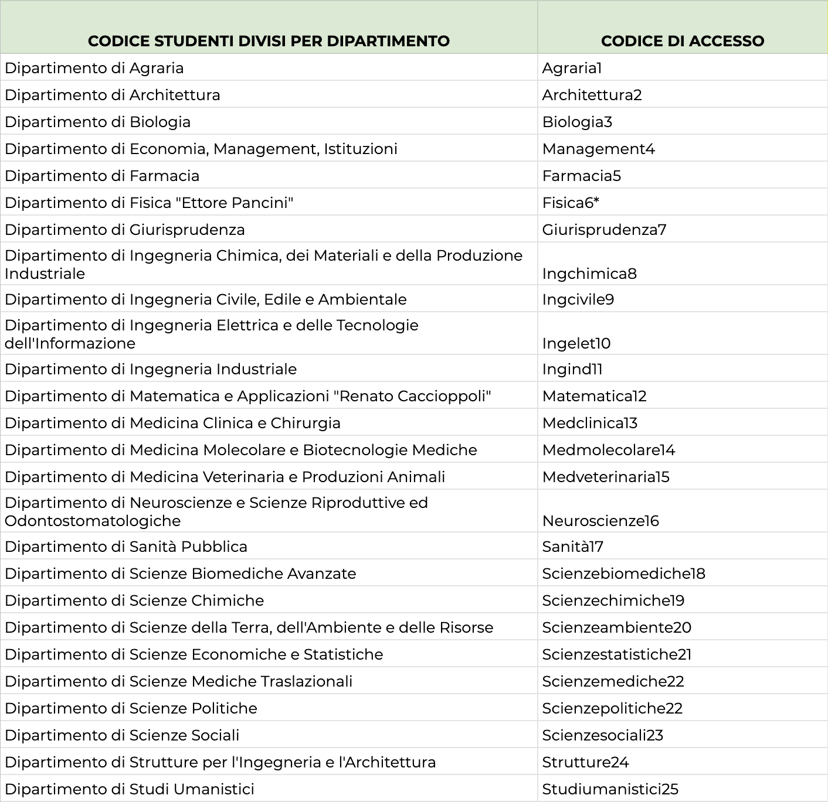
step 4.bis
If you are a STUDENT
enter your department code.

Slide 8
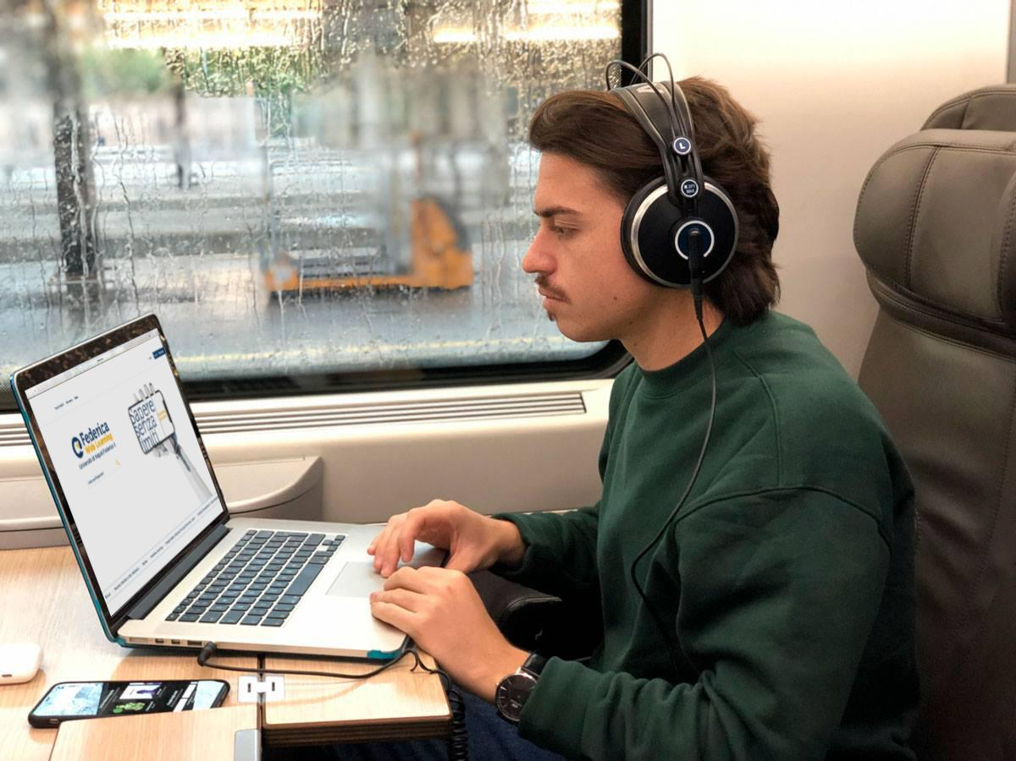
Enjoy your study!

Slide 9
Thank you!
Contacts
Help desk
support@federica.eu
Federica Web Learning
Università di Napoli Federico II
federica.eu
#SapereSenzaLimiti

